Slide 1
part 9

Slide 2
Local knowledge
• winds
• tides
• a brief tour of San Diego Bay

Slide 3
winds
• winds are generally from the west to north-west
• San Diego winds are relatively light – more than 12-14 mph is rare – small white-caps at this wind speed
• usually calm-to-light before noon and after 6:00 pm
• check National Weather Service website – go to weather.gov and enter san diego, ca for forecast at SD airport – for details, click hourly weather forecast at bottom

Slide 4
tides
• two high and two low tides each day – 6-7 hours from high to low (or low to high)
• number is relative to m.l.l.t. (mean-low-low-tide) – this is the depth given on charts
• largest swing around new and full moon – occasionally as much as 9 feet (at entrance to Shelter Island basin)
• many tide apps; I use TideGraphPro
• current can be as much as 2 knots in SD Bay – sometimes not enough wind to move boat against it – greatest current at and south of Ballast Point
• before going out, check tide and wind forecast!

Slide 5
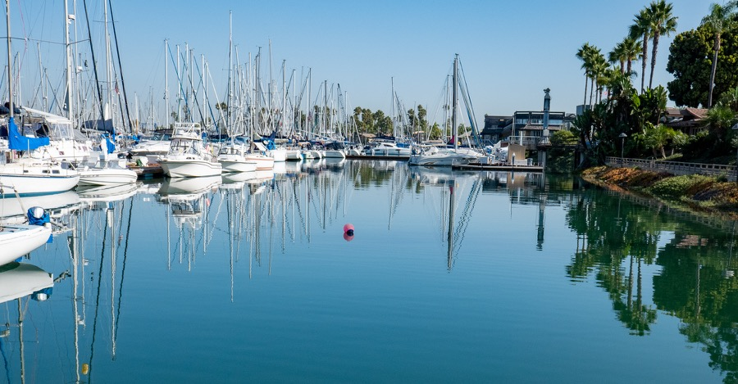
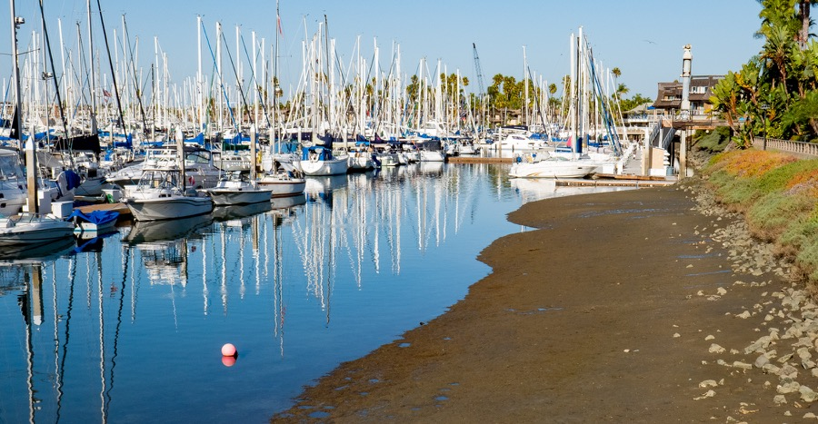
+6.7’ to -0.8’; a 7.5’ swing

Slide 6
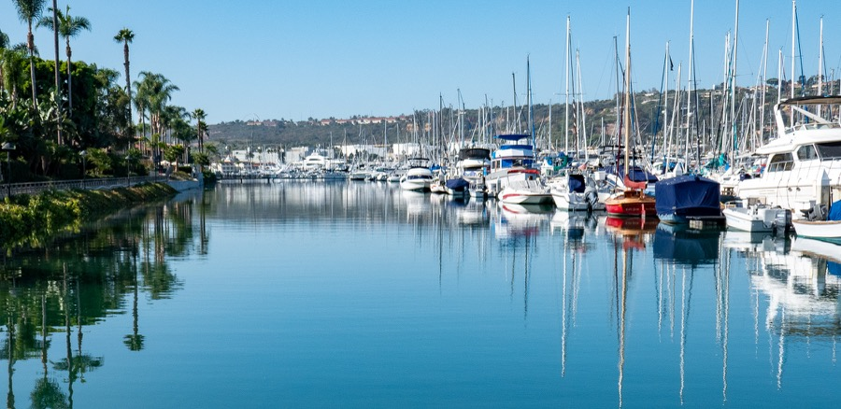
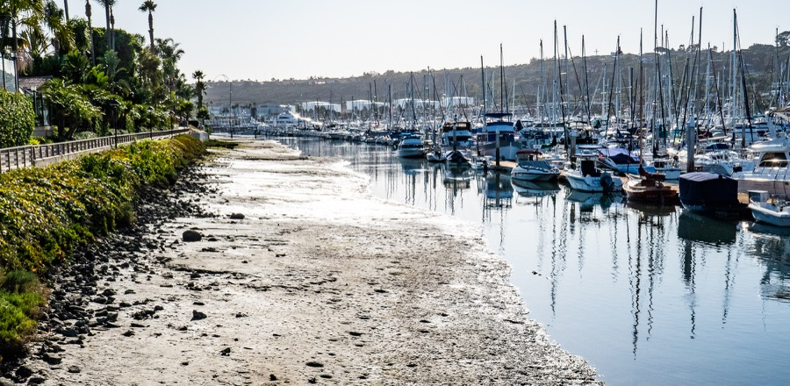

Slide 7
Sights Around San Diego Bay

Slide 8
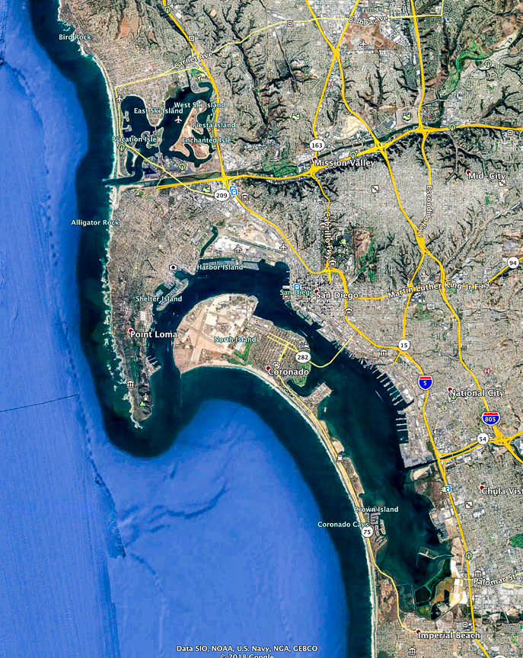
N
5
4
miles
3
2
1
0

Slide 9
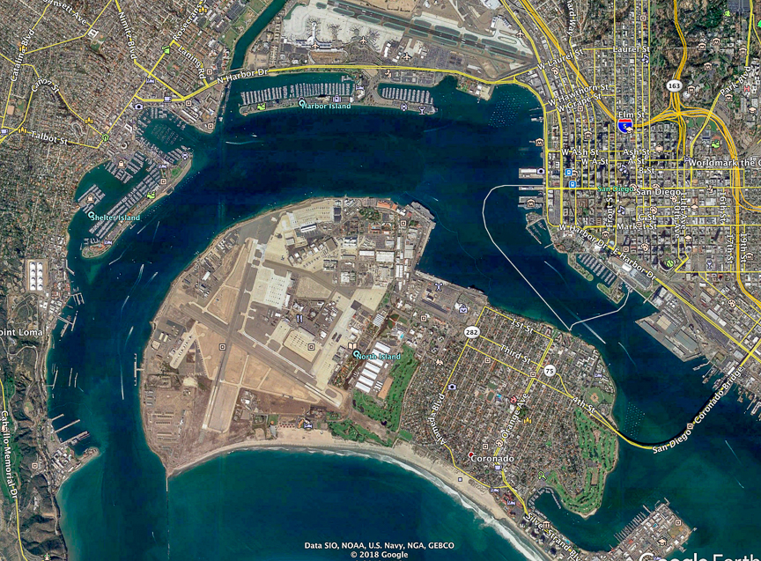

Slide 10
3.0
5.9
1.5

Slide 11
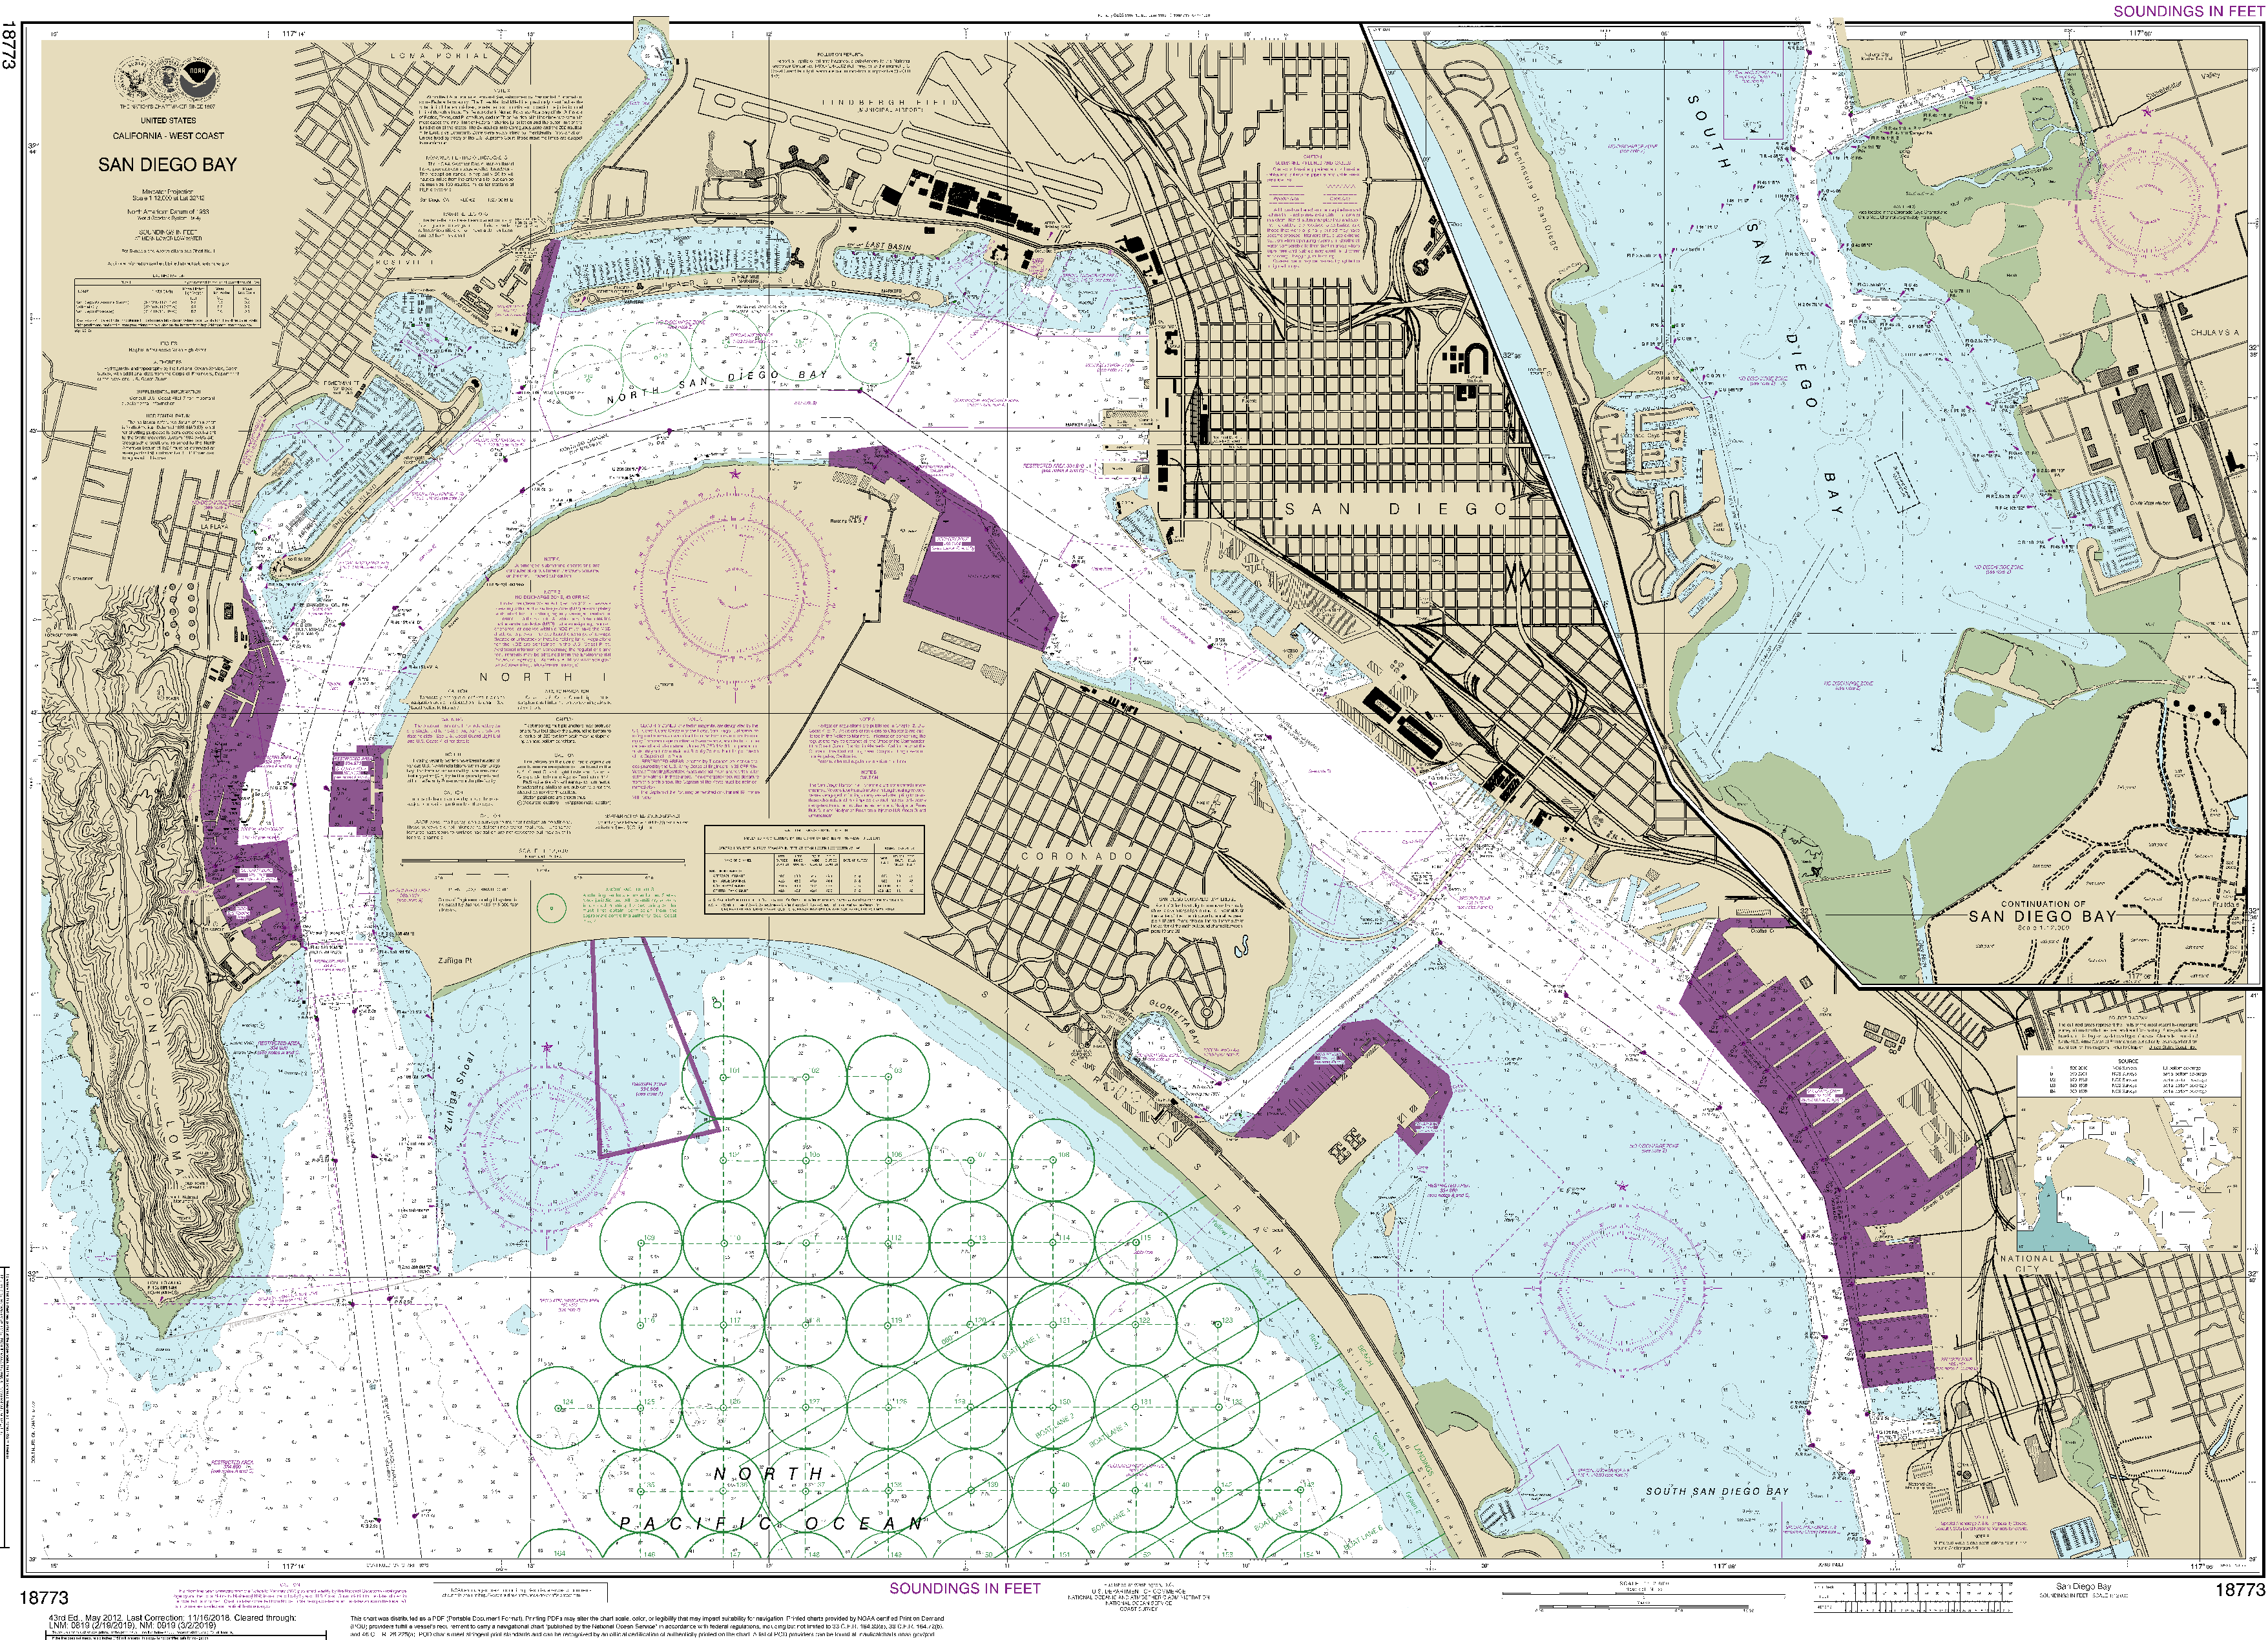
charts.noaa.gov/PDFs/18773.pdf

Slide 12
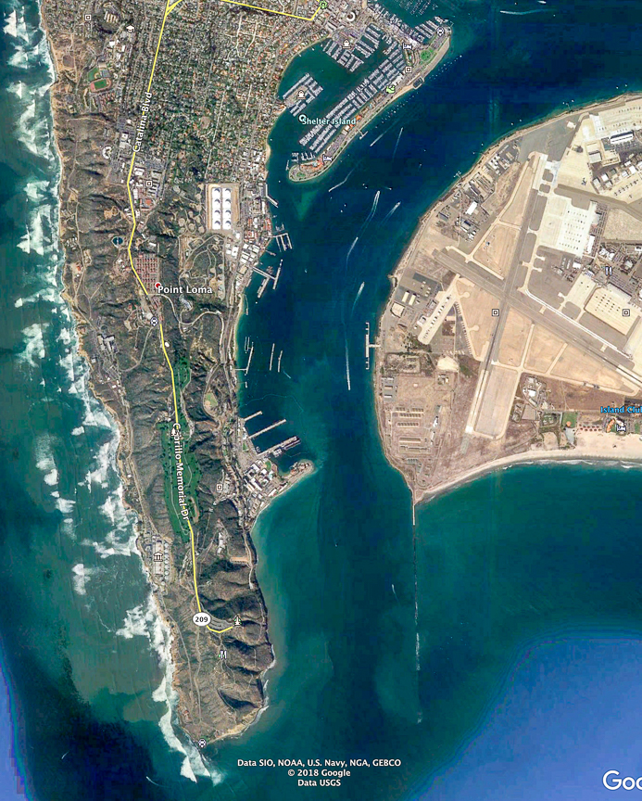

Slide 13
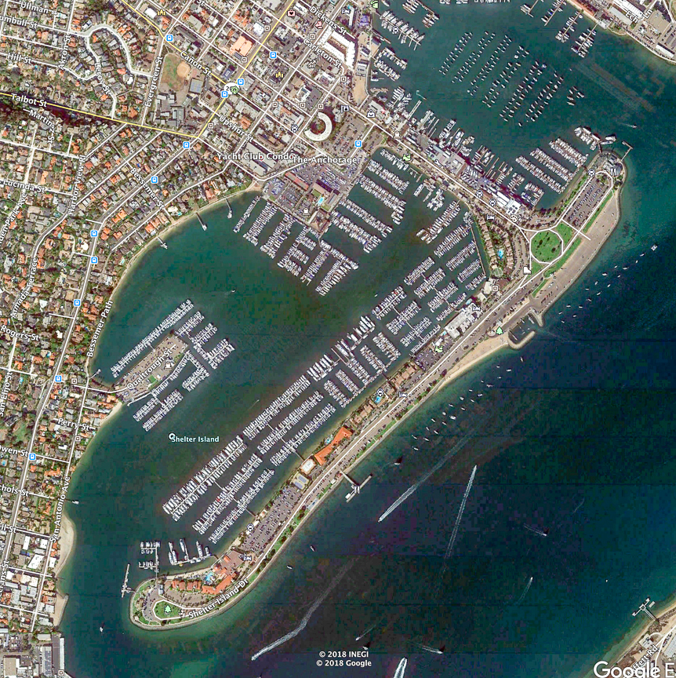
prevailing wind

Slide 14
prevailing wind

Slide 15
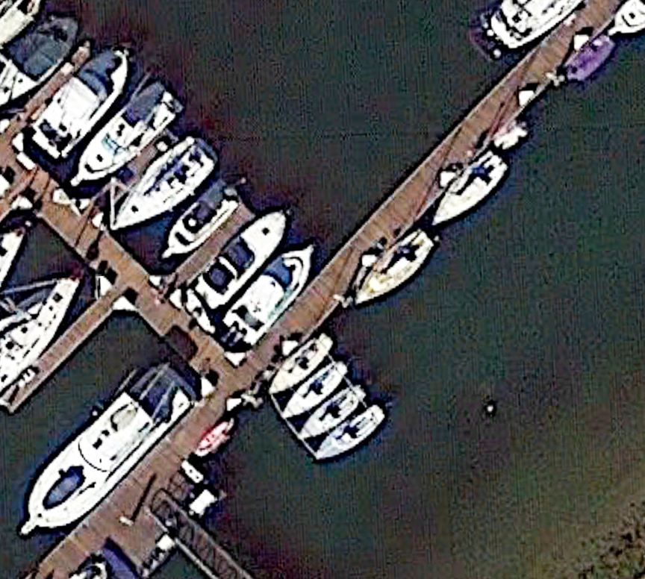

Slide 16
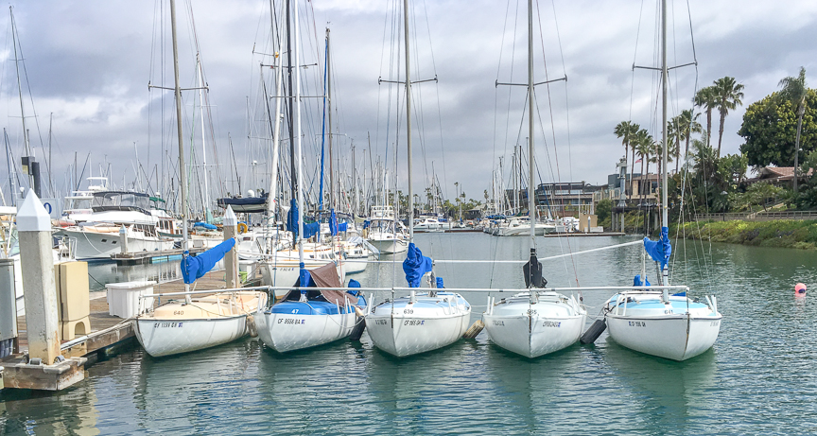

Slide 17
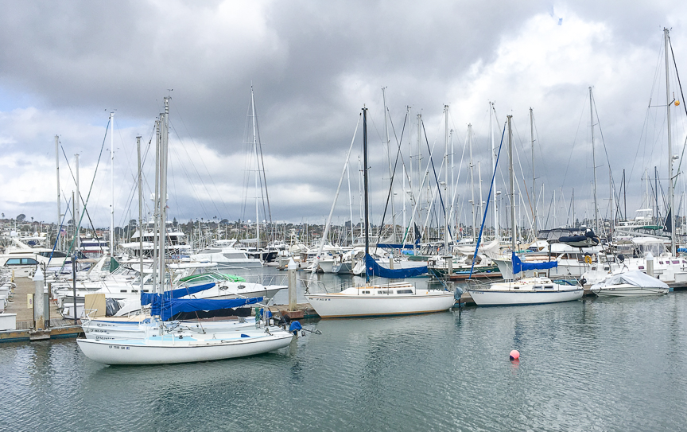

Slide 18
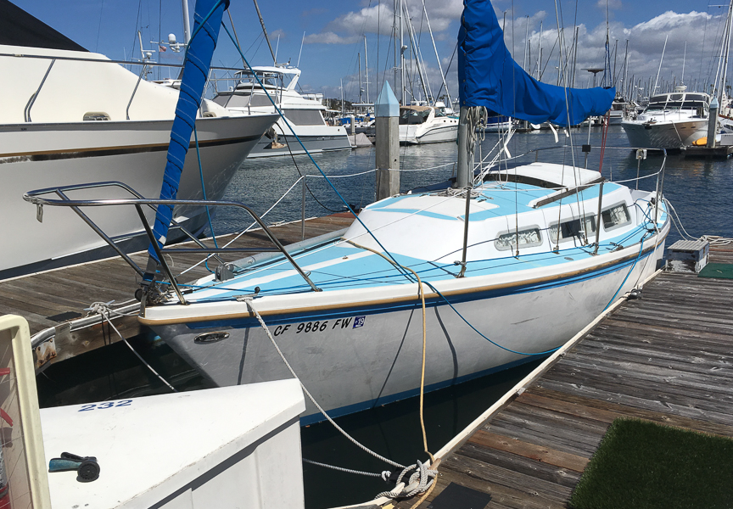

Slide 19
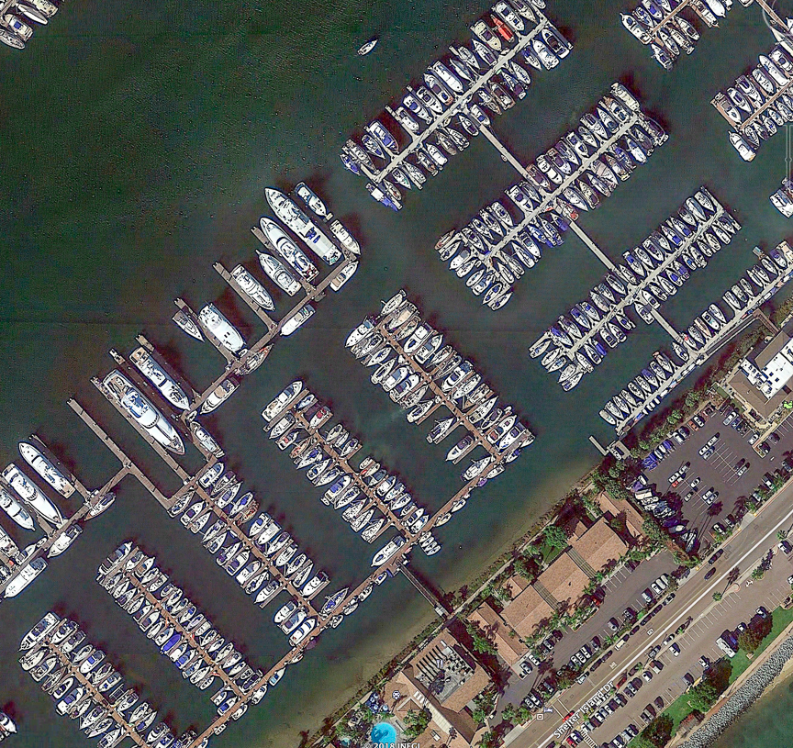
prevailing wind

Slide 20
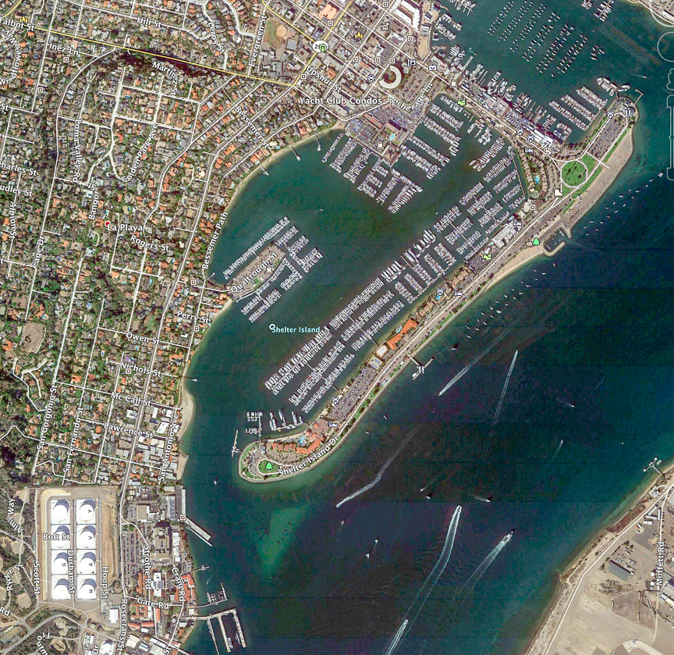

Slide 21
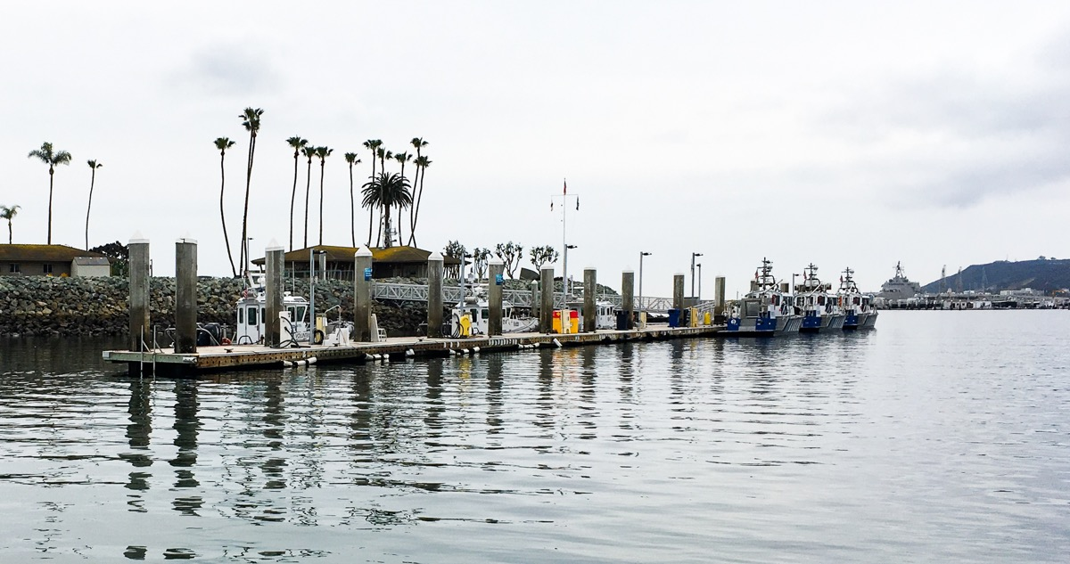

Slide 22
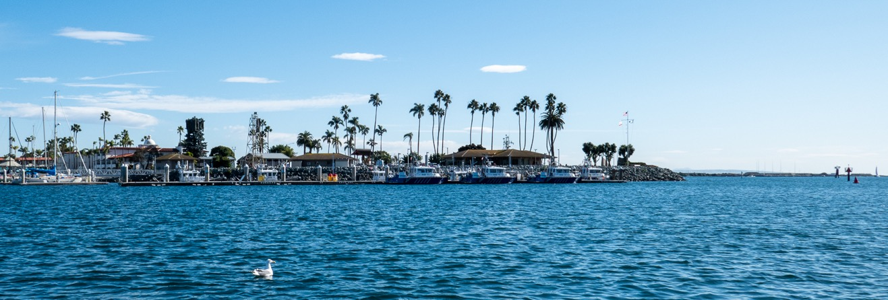

Slide 23
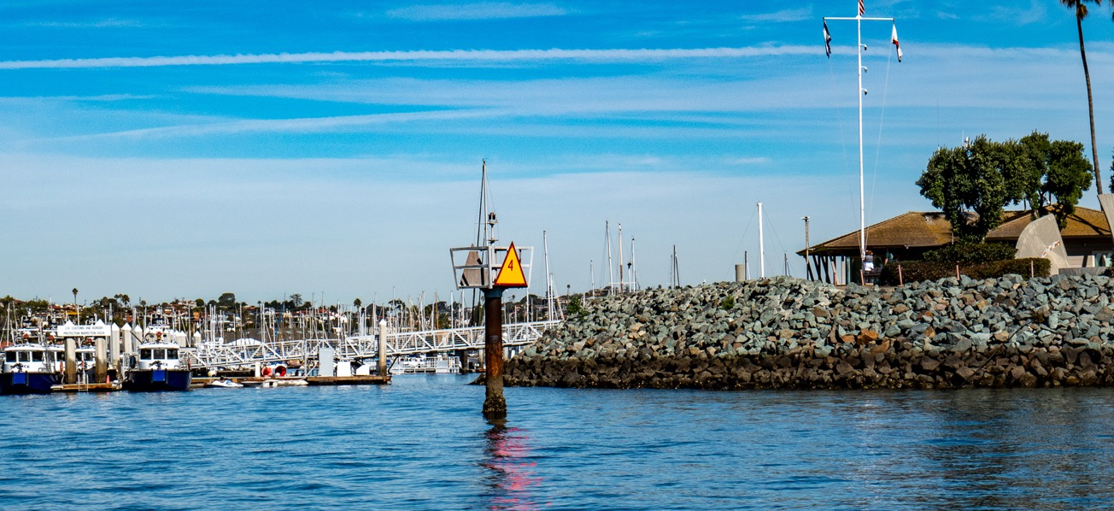

Slide 24
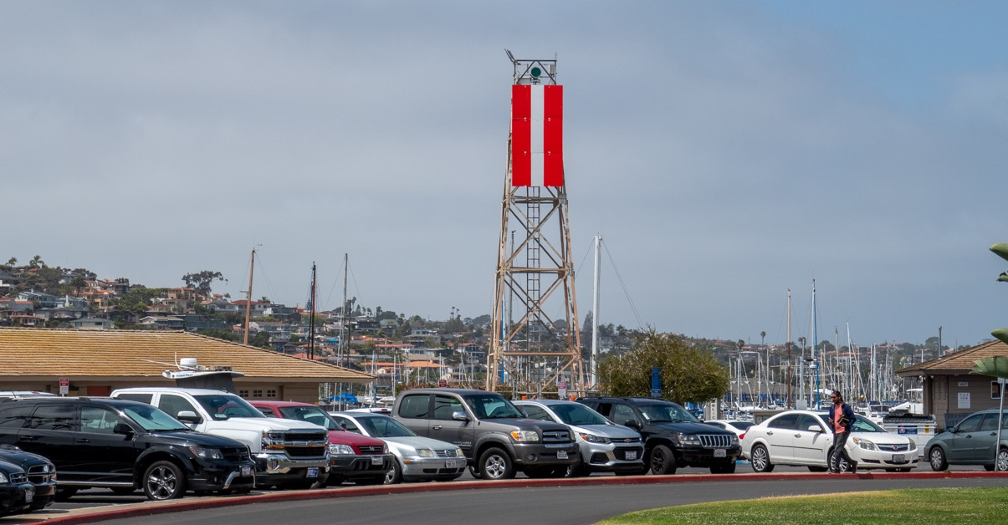

Slide 25
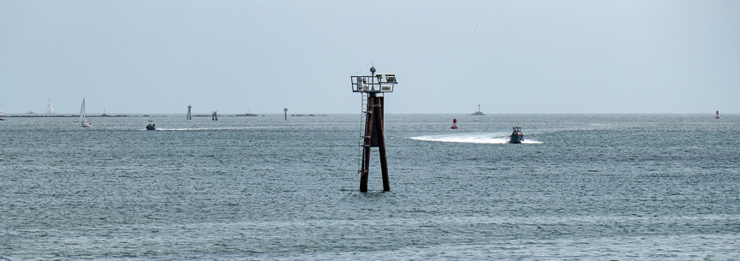

Slide 26
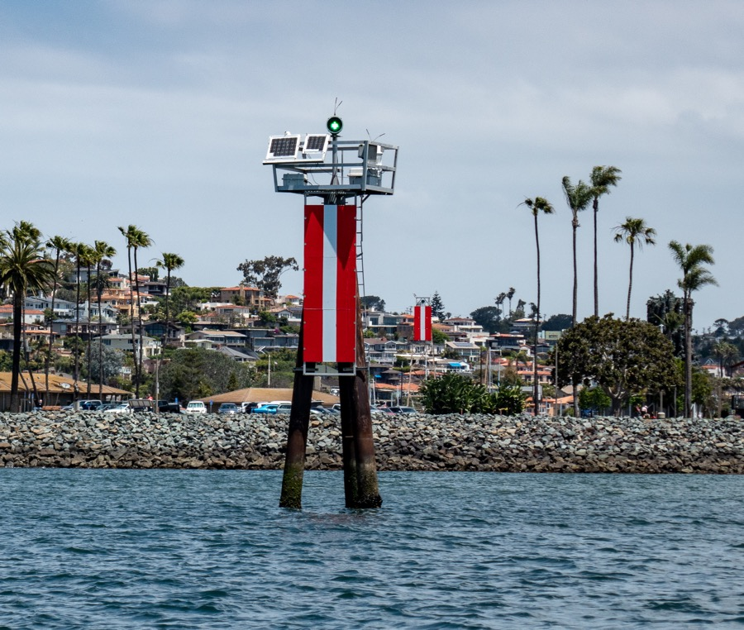

Slide 27
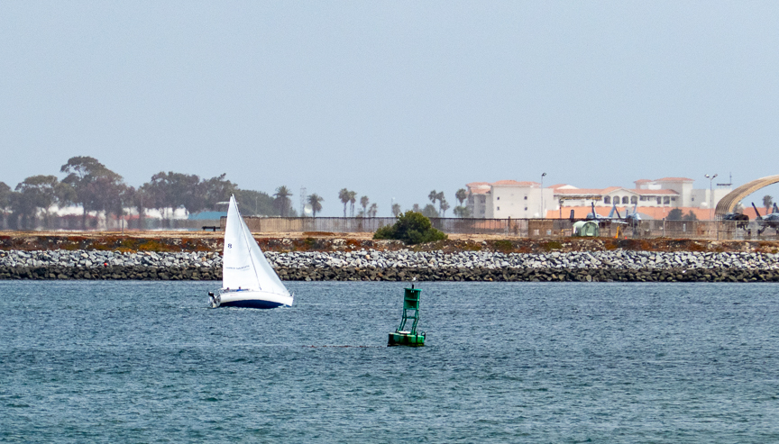

Slide 28
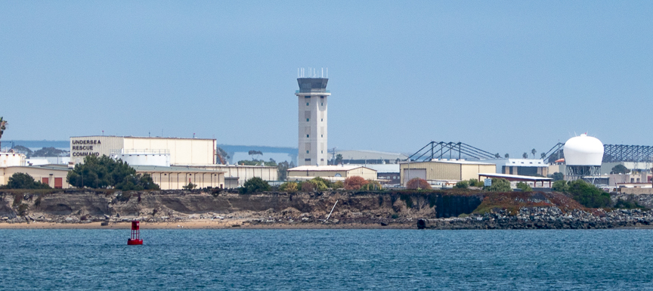

Slide 29
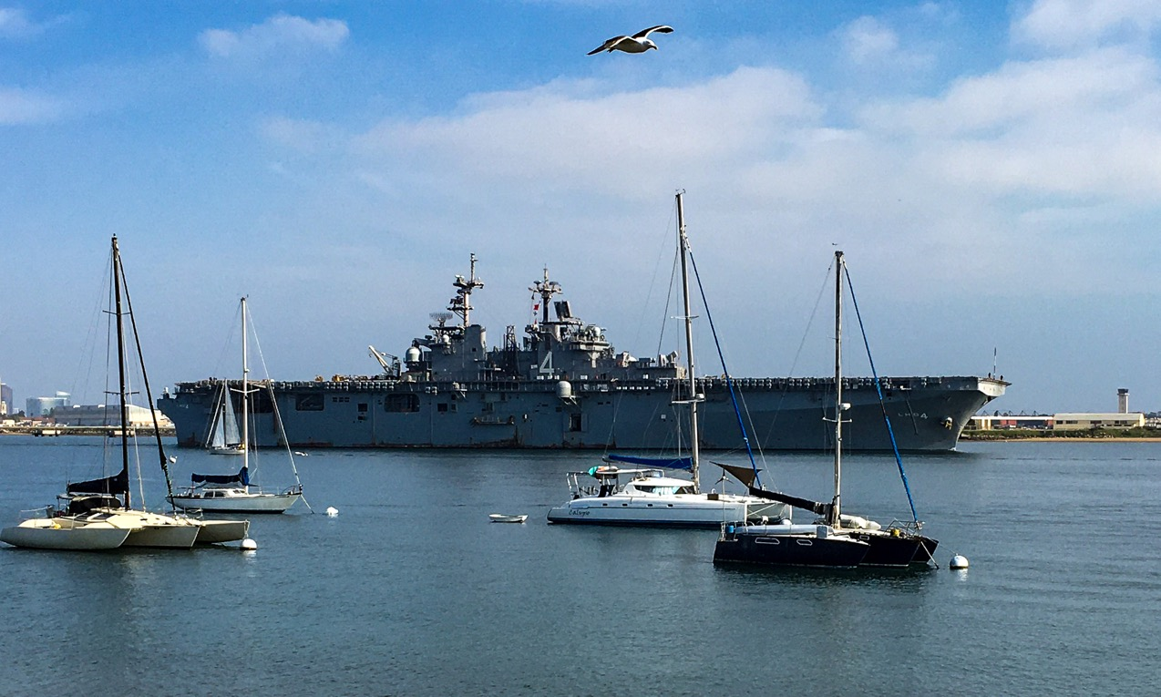

Slide 30
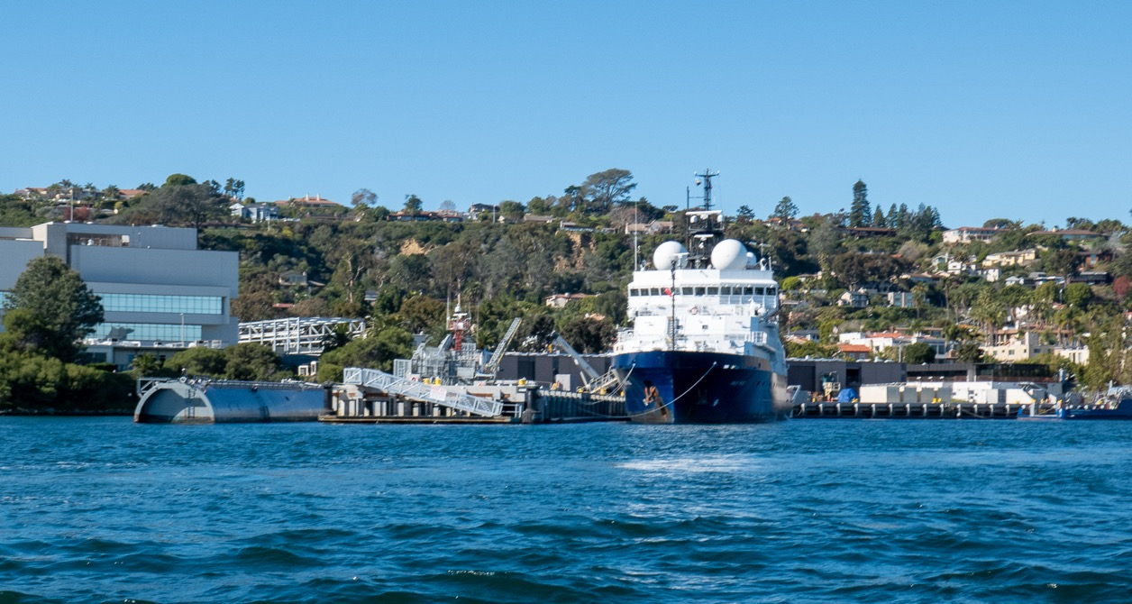

Slide 31
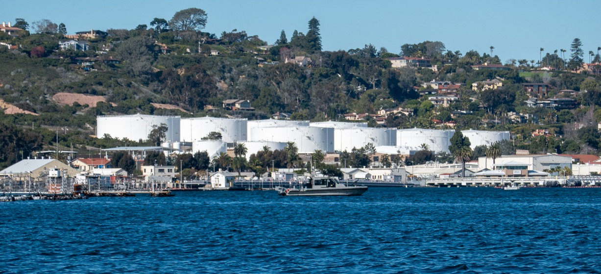

Slide 32
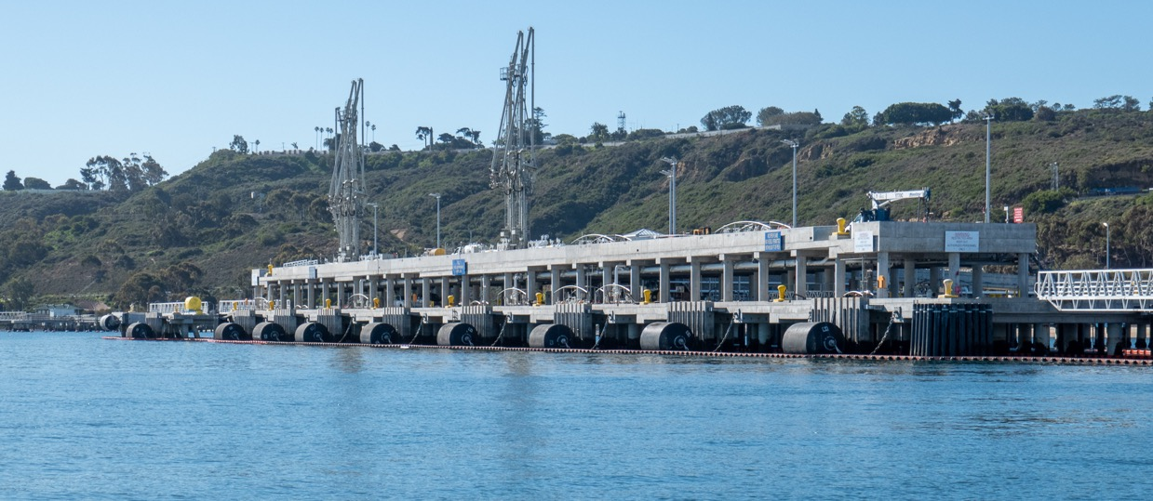

Slide 33
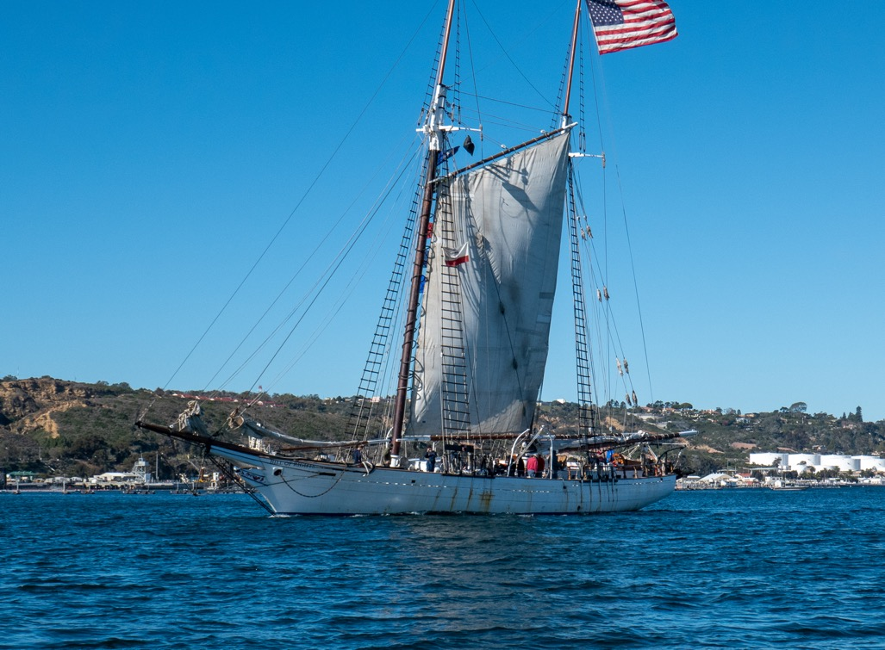

Slide 35
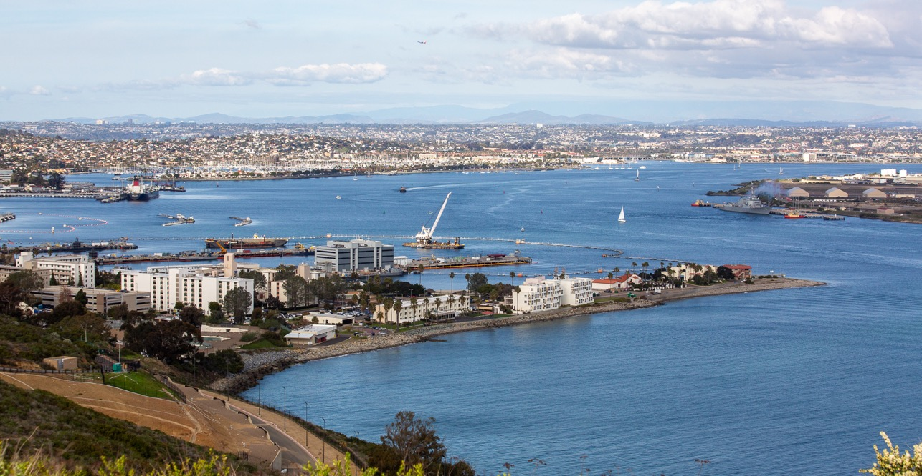

Slide 36
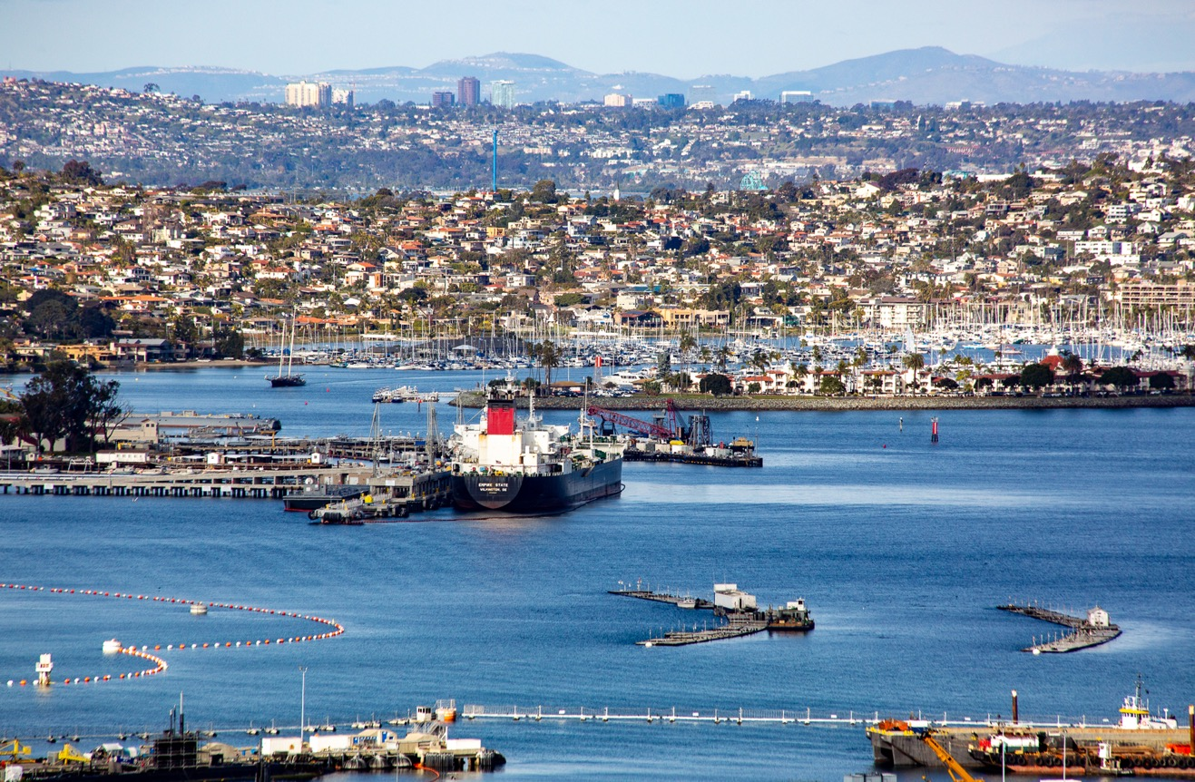

Slide 37
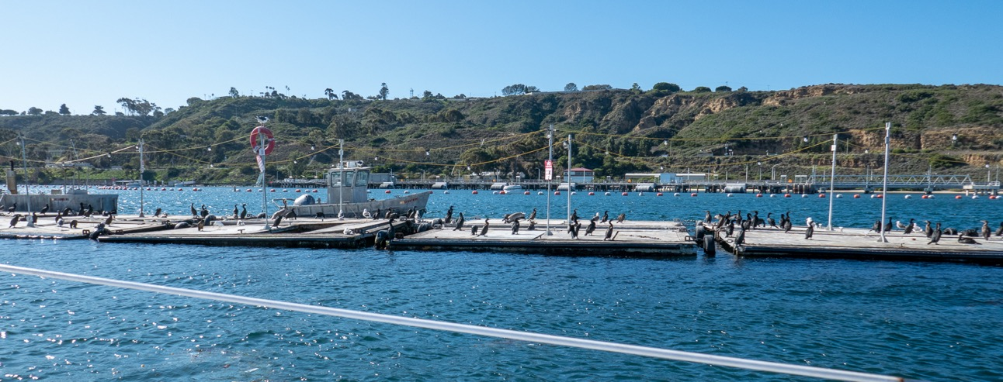

Slide 39
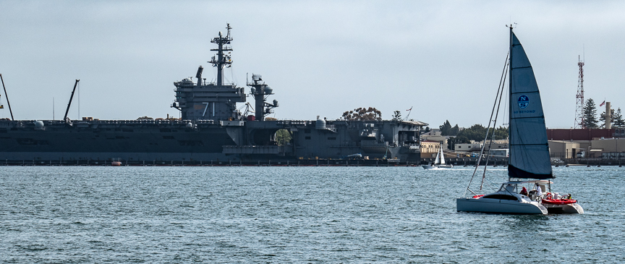

Slide 40
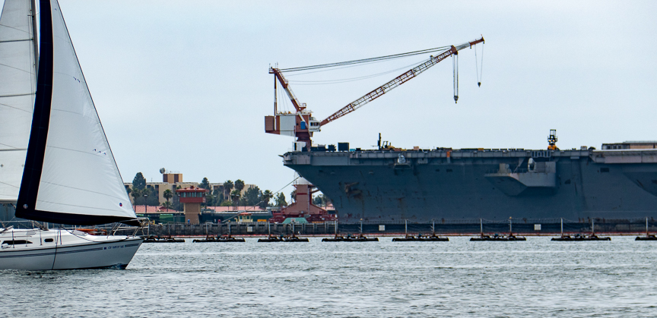

Slide 41
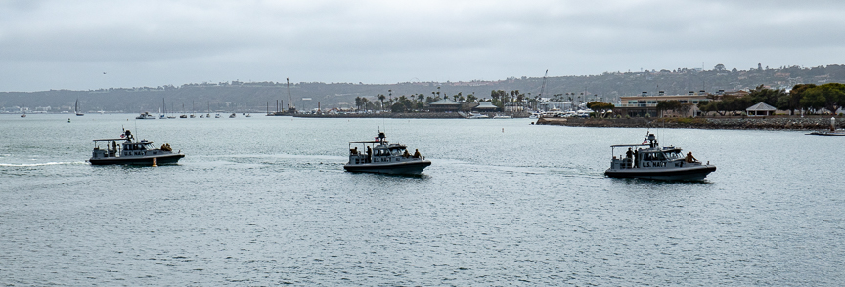
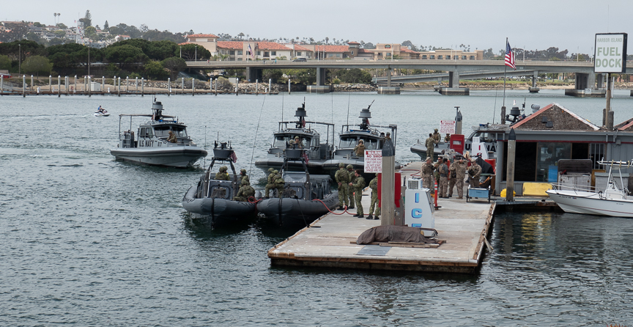

Slide 42
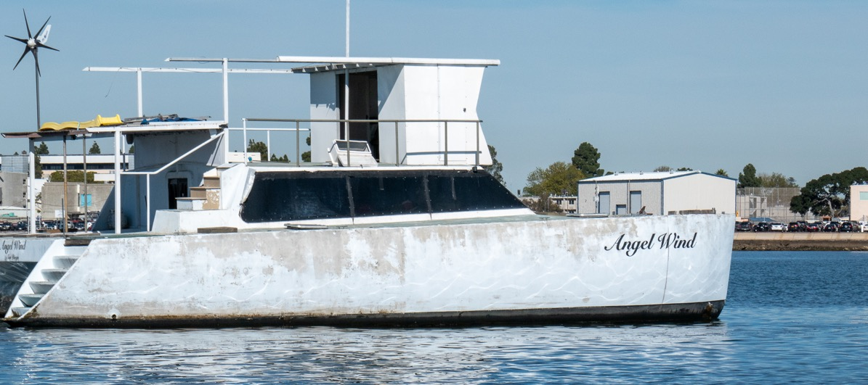

Slide 43
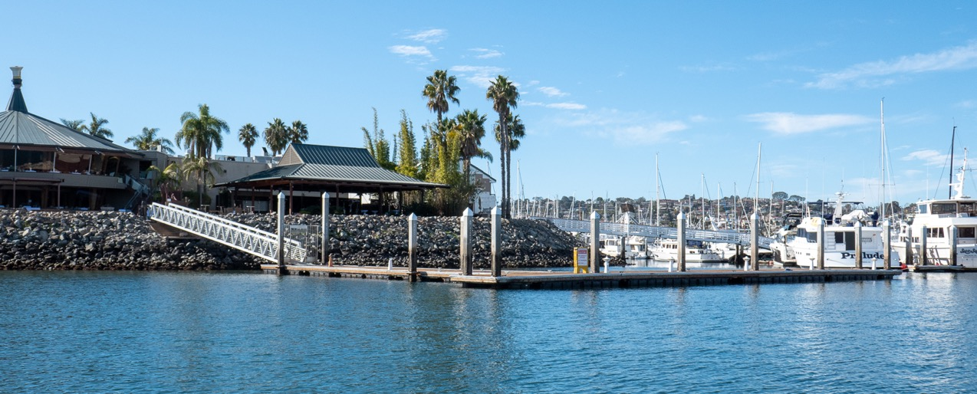

Slide 44
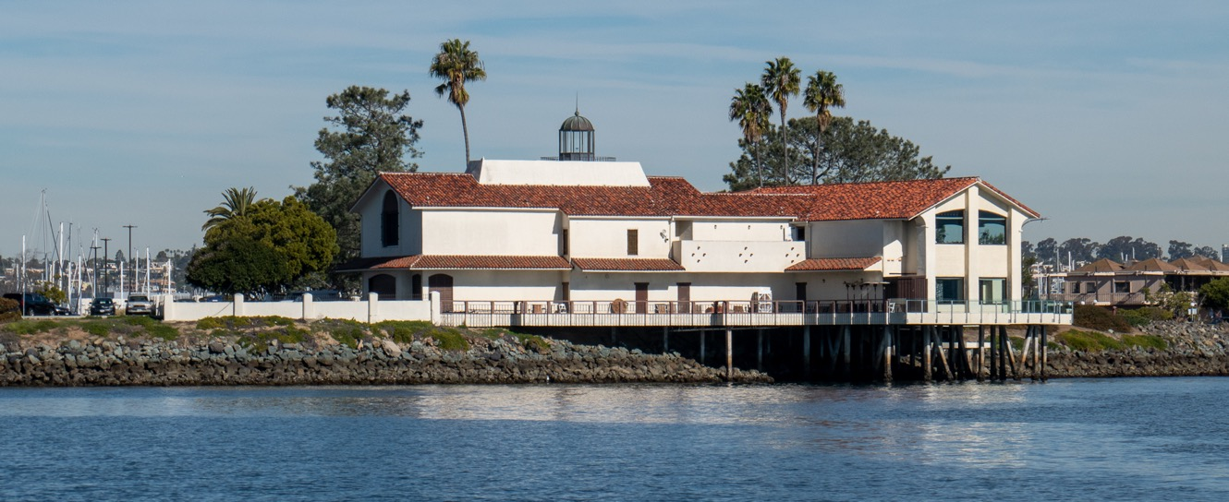

Slide 46
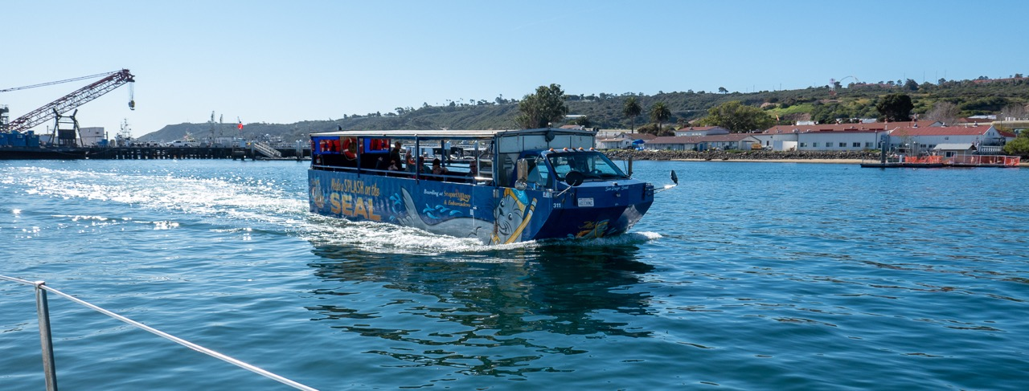

Slide 47
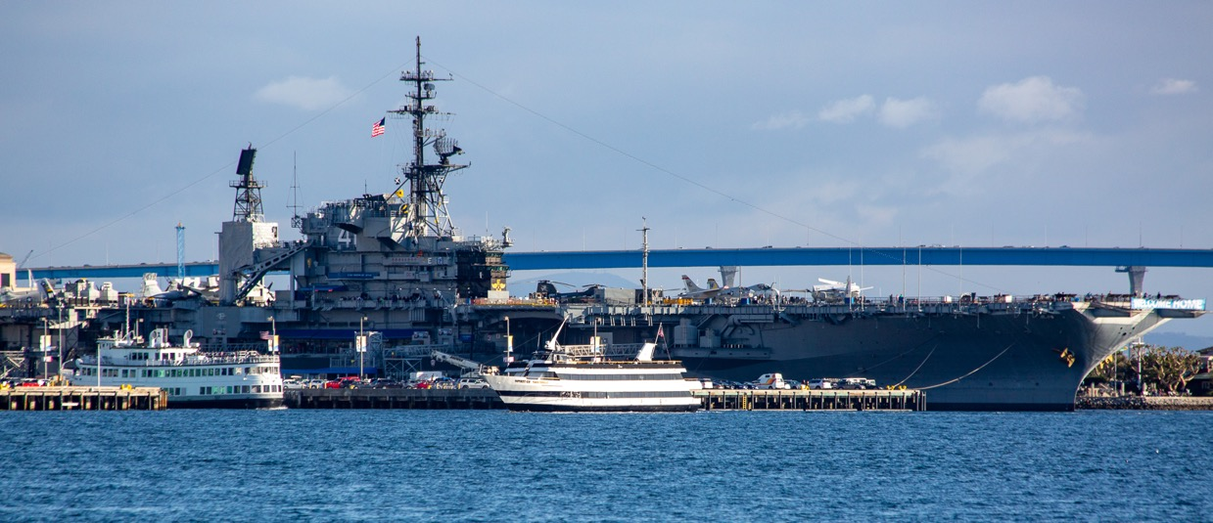

Slide 48
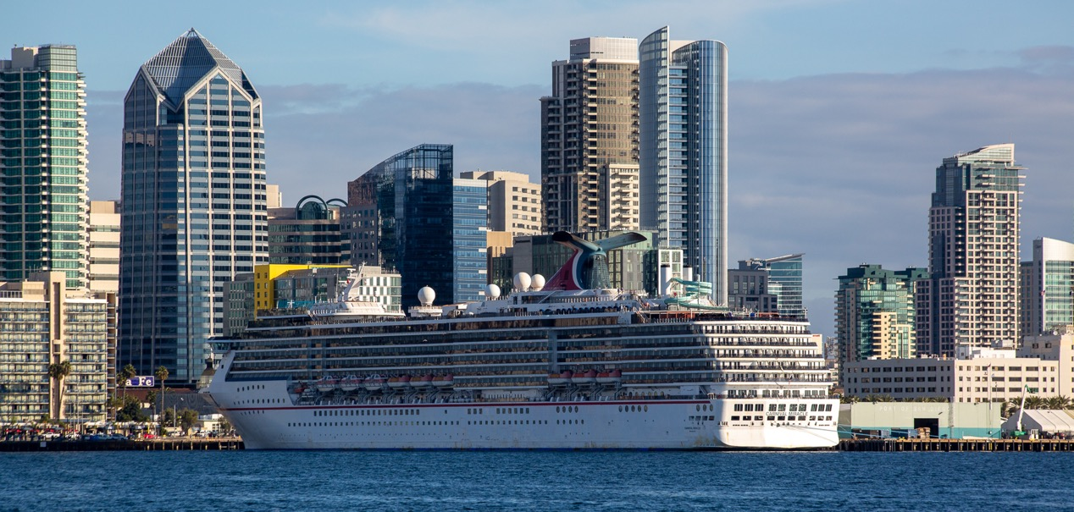

Slide 49
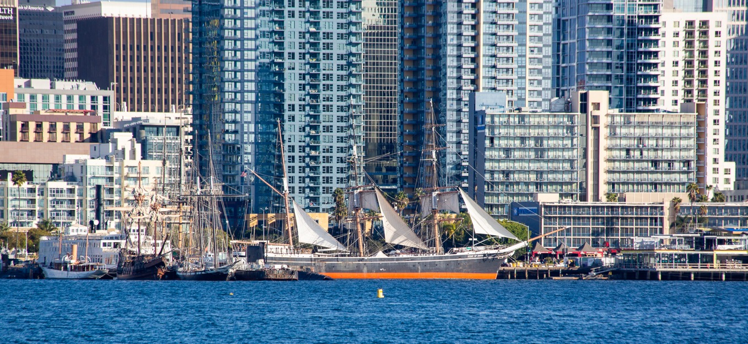

Slide 50
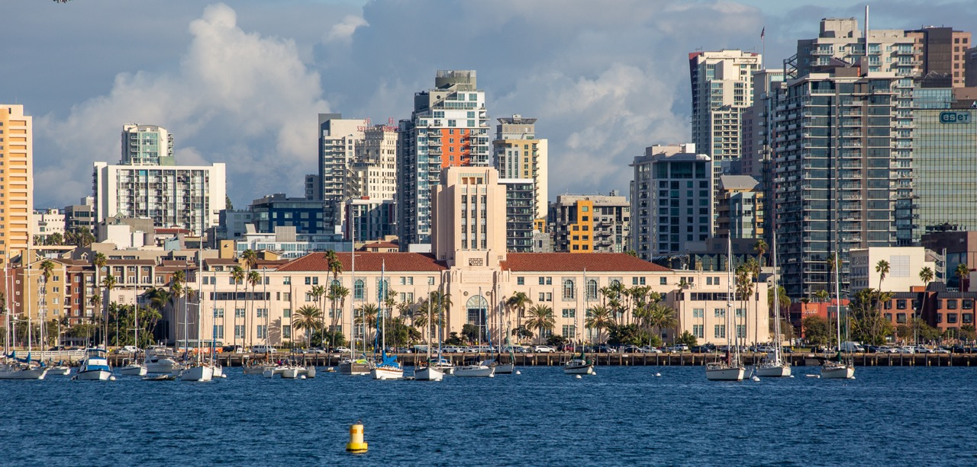

Slide 52
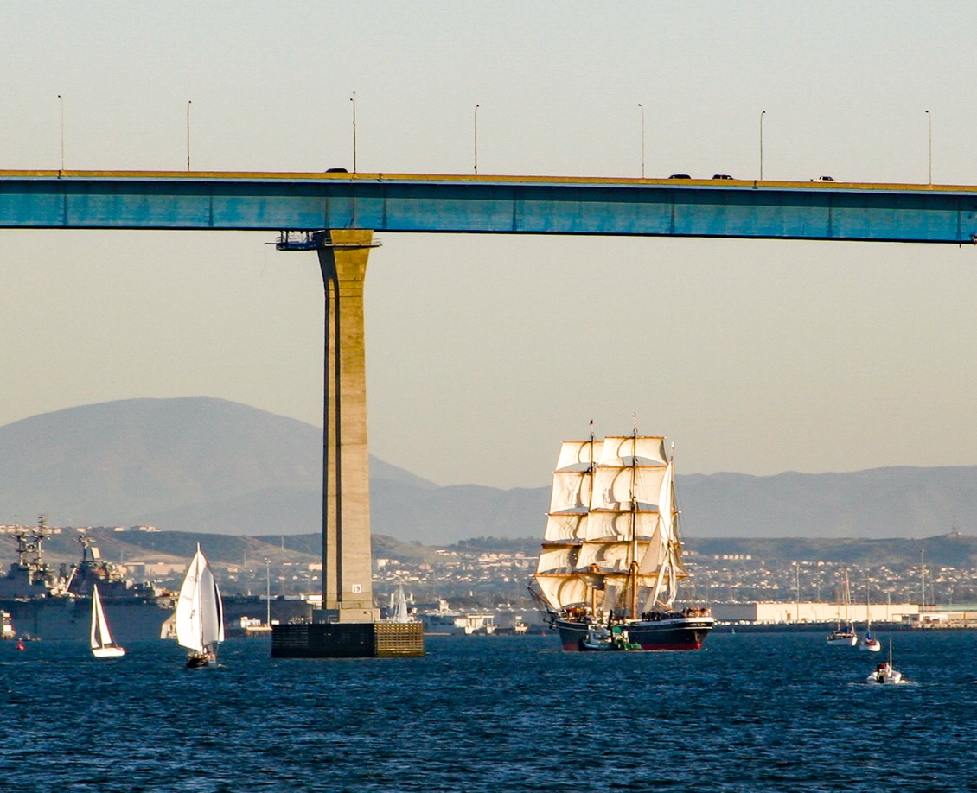

Slide 53
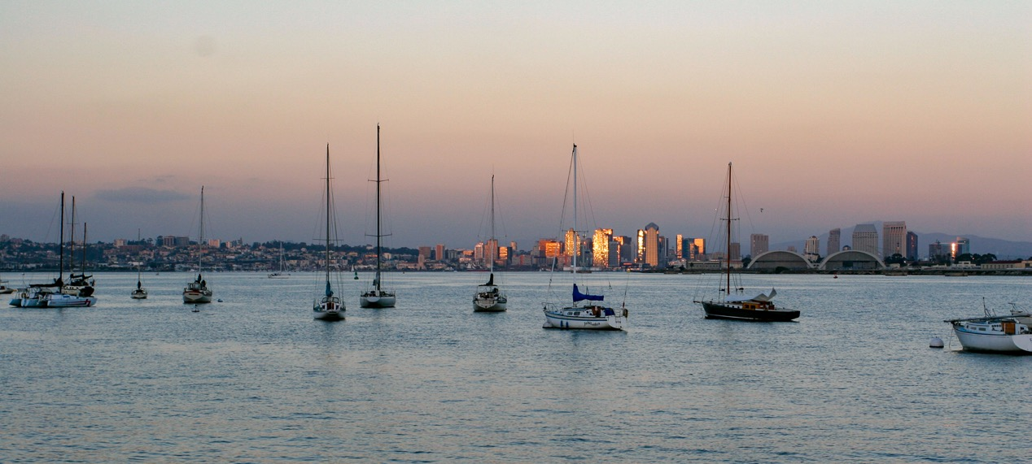

Slide 54
Thank you for sticking with it
Sail fast
Sail safe
Enjoy yourself
Join the club

